Slide 1
Lab2 Android
Team : 4-1
MURALI KRISHNA SAI CHUKKA & 09
RUPESH SAI RAM DODDALA & 10
TEJASWI AYYADAPU & 03

Slide 2
Android Lab details.
Login and Registration with firebase.
Machine Learning API – (We used IBM Watson Vision API).
Use any of the smart phone hardware features (We used Camera).

Slide 3
Demo
Demo

Slide 4
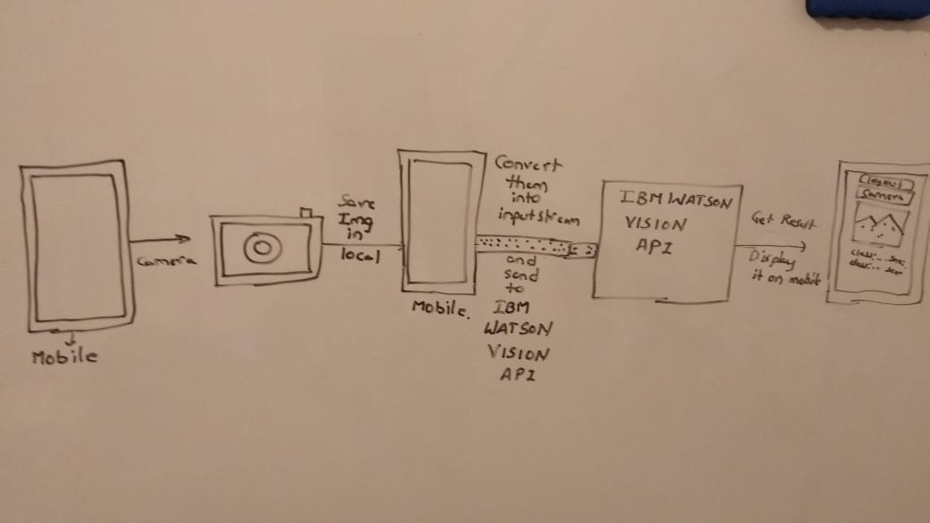
Design Explanation

Slide 5
Code Explanation
Android Code Explanation

